Slide 1


Engineering Safety and Risk Management Program
ENGG404 – Seminar #3 of 6:
Team Project Assignment
ESRM - ENGG404 LRM
1
Notes:
ENGG404 Lecture 00 - Day 1
2012 Fall
1
1

Slide 2
Seminar: Team project
Today:
Team Contributions & Deductions
Effectiveness, Engagement, and Collaboration for High Performance Teams
ITP Metrics Midterm Peer Feedback Process
Progress Report Chapters:
Cause and Effect Model
Executive Summary
Team Project Seminar #1 of 8

Slide 3
Team Project Assignment for ENGG404
At the end of this seminar, you should be at this stage of the project:
Item in Progress Report | Expected Progress
Cover Page and Table of Contents | Done
Executive Summary:
ES: Incident Description and Losses | Starting
ES: Context and Purpose of Your Incident Investigation | Starting
ES: Root Cause Analysis Summary | Starting
ES: List of the Latent Causes | Starting
Appendices:
Chapter 1: Incident Description and Losses | Done
Chapter 2: Context and Purpose of Your Incident Investigation | Done
Chapter 3: Root Cause Analysis – Discussion | Developing, almost done
Chapter 4: Application of the Cause and Effect Model | Starting
References
Appendix A: Root Cause Analysis – Chart | Developing, almost done
Spelling, Grammar, Format, Organization, Presentation, Rational and Logic; Overall Flow
ESRM - ENGG406
3
Notes:
3

Slide 4
Team Project Assignment for ENGG404
ENGG404 Course Syllabus: Seminar Attendance
Portions of each seminar are mandatory attendance beginning with the first of the Team Project seminars, the Week 3 Seminar unless stated otherwise in the Course Plan.
No marks are awarded for attendance; however, failure to attend may result in a deduction of 2% per seminar on your final mark e.g. if you miss 3 seminars, the deduction on your final mark is potentially 6%.
If you have a conflict, talk to the professor well in advance of the seminar so that alternate arrangements can be made.
If you miss a seminar, consult with your professor to resolve for excusable reasons.
In all cases, consult with your team to ensure that you are not neglecting your responsibilities towards fair and equitable contributions to your team.
ESRM - ENGG404 LRM
4
Notes:
4

Slide 5
Team Project Assignment for ENGG404
ENGG404 Course Syllabus: Peer Feedback Surveys
The Peer Feedback Surveys, or comparable method, is the preferred academic survey process for peer evaluation and feedback.
The survey will be formally used in this course two times, mid-term and at the end of the course.
Your completion of the surveys is mandatory. No marks are awarded for completing the survey; however, failure to complete the survey as required may result in a deduction of 3% per non-completion on your final mark e.g. if you do not complete both surveys, the deduction on your final mark is potentially 6%.
If you miss completing a survey, consult with your professor to resolve for excusable reasons.
The feedback will be anonymous and only seen by the instructor. The feedback will be used to assess fair allocation of marks in the Team Project.
ESRM - ENGG404 LRM
5
Notes:
5

Slide 6
Chapter 3: Team Project Assignment for ENGG404
ENGG404 Course Syllabus: Peer Feedback Surveys
Full participation and contribution by all team members on the team project is not only encouraged BUT ALSO EXPECTED. Lack of participation and/or contribution may result in a deduction on an individual’s total team project score.
If team management issues arise and the team cannot self-manage it, the concerned team members should contact the professor for guidance, and perhaps intervention. Please do not wait until it is too late to ask for help from the professor to help resolve dysfunction within the team.
Two behaviours: “Reap benefits without the effort” and “Control by one or more members to the exclusion of the individual” may result in a negative adjustment of an individual’s mark on the team project i.e. a deduction. Adjustments may be made on either of two latter cases.
ESRM - ENGG404 LRM
6
Notes:
6

Slide 7
Team Project Assignment for ENGG404
ENGG404 Course Syllabus: Peer Feedback Surveys
A sliding scale on the Peer Feedback Survey combined with students’ comments/feedback and instructors’ observations are used to apply the deduction for non-participation and/or non-contribution:
The range of deduction takes into account the feedback comments and allows for either a) differentiating between one student who scores 2.5 and another who scores 3.4, or b) the extent of comments given by team-mates e.g. the deduction for a score of 4.4 may be as little as 1% if no supporting comments.
Example 1: The individual’s total score on the team project is calculated as (1 - %Deduction) times the Total Team Project Score. If a team scored a Total Team Project Score of 25% out of 30%, and an individual’s deduction is 10%, the individual receives a score of (1 – 10%) times 25%, or 22.5% out of a possible 30%.
Example 2: For the lowest range, there will be a detailed review of all concerned. The deduction ranges between 50% and 100% i.e. a deduction of 100% of the team project component may apply if it has been verified that the student in question did not contribute at all to the team project i.e. the student earns 0% on the team project component of their final mark.
ESRM - ENGG404 LRM
7
Notes:
7

Slide 8
Chapter 6.5: Effectiveness, Engagement, and Collaboration for High-Performance Teams
On becoming a leader in Risk Management
ESRM - LRM

Slide 9
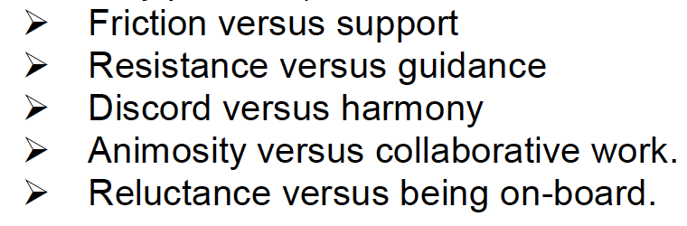
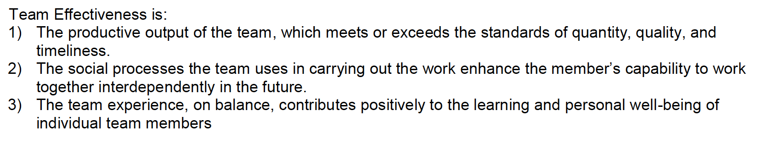
Working in Teams
What have your past team project experiences been like?
What should a good team look like?
Chapter 6.5

Slide 10
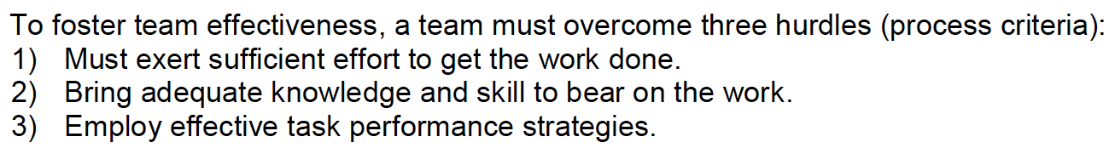
Working in Teams
A way forward for successful teams:
Need to implement a system that improves:
Communication, Coordination and Collaboration
The three Cs of team effectiveness.
Others are Cooperation, Comforting, Conflict Resolution, Cohesion
What should a good team look like?
Chapter 6.5

Slide 11
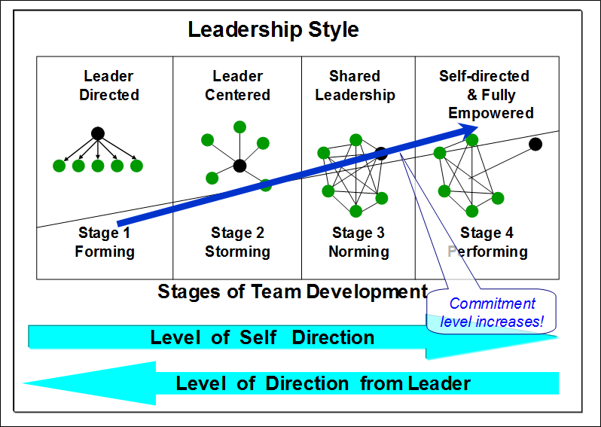
Effectiveness, Engagement, and Collaboration for High-Performance Teams
Tuckman’s Model for Leadership Style and Team Development:
Leadership style varies with each stage of team development
With team evolution, commitment level rises (improved culture) and performance level and team output increases.
ESRM - LRM
Notes:
Stage 1 – old school engineering – leader directed. One boss tells everyone what to do
Stage 2 - the leader is in the centre guiding the work - everyone is supporting the leader
Stage 3 - everyone has shared leadership duties – but who is making the decision
Stage 4 – Different people take the lead at different times, depending on skills
DESCRIBED BETTER IN NEXT SLIDE!

Slide 12
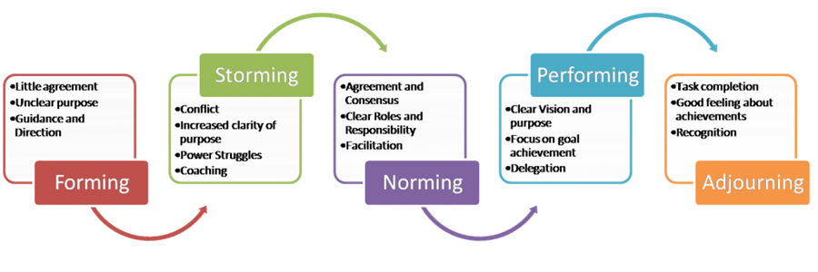
Effectiveness, Engagement, and Collaboration for High-Performance Teams
The Five Stages of Team Development:
Tuckman & Jensen (1977)
ESRM - LRM

Slide 13
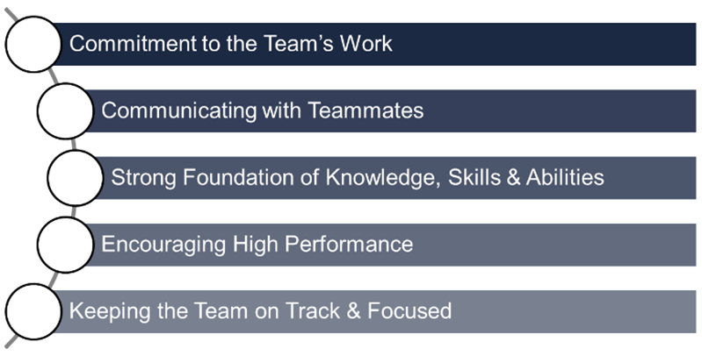
Team Project Assignment for ENGG404
The Process for the ITP Metrics Peer Feedback Survey
You now have an opportunity to informally apply the ITP Process.
Five Gauge Points of Effectiveness in ITP Metrics:
4.5 to 5.0 = Outstanding
3.5 to 4.5 = Strong
2.5 to 3.5 = Moderate
1.5 to 2.5 = Bare Minimum
1.0 to 1.5 = Unsatisfactory
ESRM - ENGG404 LRM
13
Notes:
13

Slide 14
Team Project Assignment for ENGG404
The Process for the ITP Metrics Peer Feedback Survey
Using the table below as was just described, make sure you provide:
“one or two positives” for each of your team-mates, AND
“one opportunity for improvement” for each of your team mates (constructive criticism)
ESRM - ENGG404 LRM
14
Notes:
14

Slide 15
Team Project
The Process for the ITP Metrics Peer Feedback Survey
Practice “valuable and constructive feedback”:
Specific, Accurate, and Constructive:
DO SAY “To avoid duplication of work, it would be beneficial if you could upload documents to the dropbox when you first create a new file, and use more specific file names.”
Future-Oriented:
DO SAY “Team meetings would be more productive if you are able to prepare for them beforehand and come to the meeting with your assigned work completed and ready for review by others.”
Target Behaviour:
DO SAY “I feel that the team really benefits from your ideas, in future meetings we would love to hear more from you. Your opinions are valuable so it would be great to see you become more involved in these conversations”.
ESRM - ENGG404 LRM
15
Notes:
15

Slide 16
ENGG404 Team Project
Root Cause Analysis and the Cause & Effect Model
The cause and effect model aids in the development of the root cause analysis for your project.
The cause and effect model helps to identify and ‘drill down’ to the latent causes, including:
Immediate causes
Intermediate immediate causes
Basic causes
Intermediate basic causes
Latent causes
If you can still answer the question ‘why’, you are NOT at a latent cause!
Once identified, the latent causes need to be linked to an element of the Risk Management System Elements (RMEs)
The latent causes reflect weaknesses or inadequacies in the Risk Management System Elements
The latent causes show areas where meaningful management action can be taken relative to the Risk Management System (i.e. recommendations)
ESRM - ENGG404
16
Notes:
16

Slide 17
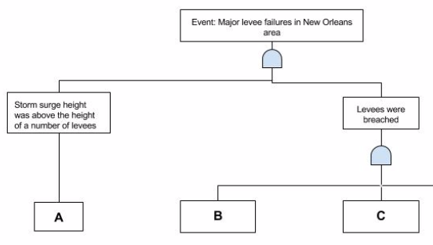
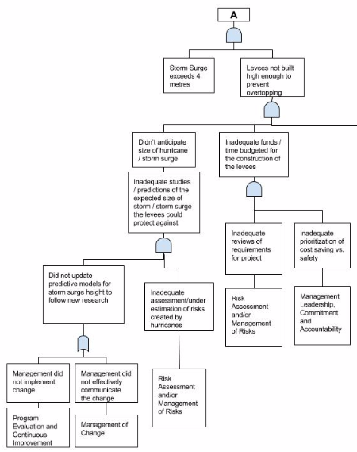
ENGG404 Team Project
Team Project Progress Report:
Application of the Cause and Effect Model - Discussion:
Your RCA Chart
ESRM - ENGG404
17
Notes:
17

Slide 18
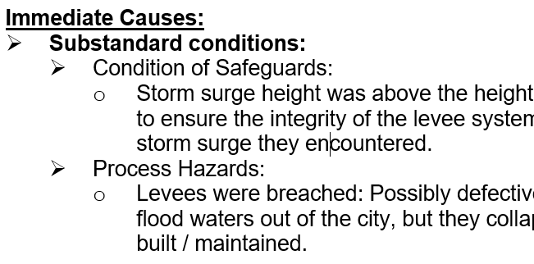
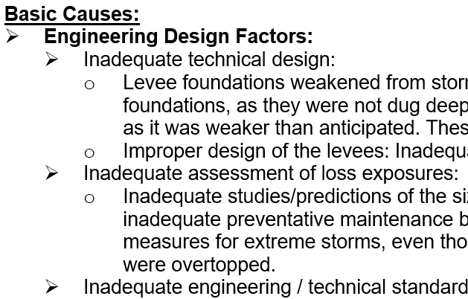
ENGG404 Team Project
Team Project Progress Report:
Application of the Cause and Effect Model - Discussion:
Your RCA Chart
Chapter 4.2: The Cause and Effect Model for Incident Analysis- An Example
ESRM - ENGG404
18
Notes:
18

Slide 19
ENGG404 Team Project Assignment
Team Project Progress Report:
Application of the Cause and Effect Model - Discussion:
Your RCA Chart
Module 4-05: The Cause and Effect Model for Incident Analysis- An Example
ESRM - ENGG404
19
Notes:
19

Slide 20
ENGG404 Team Project Assignment
Team Project Progress Report: Executive Summary
The Executive Summary is a summary. It is better to create and complete the chapters first, and then summarize your chapters
Each section of the executive summary should summarize the corresponding appendix and provide key points of information, depending on the context and nature of the section. The executive summary must include:
The Loss Incident and the Losses With Respect To PEAP.
The Context and Purpose of your Incident Investigation Report.
Root Cause Analysis: The scope and boundaries of the root cause analysis, and two specific key latent causes that each clearly shows alignment to a risk management system element.
List of Latent Causes: Aligned with the applicable Risk Management System Elements, as found from your RCA and your applied C&E Model. You must provide at least different 18 latent causes in bullet point or table format.
Two (2) pages maximum for the Executive Summary. A penalty will apply for exceeding 2 pages!
ESRM - ENGG404
20
Notes:
20

